Slide 1
IBM University Engagement Project Submission
“Exploring the Power of Agentic AI with IBM Granite and IBM Bob”

Slide 2

Project Tile – AI-Powered LaTeX TikZ Diagram Generator
Domain of Project – Education / Academic Productivity
Student Name | Recent Passport Photo | Email ID | Mobile number [WhatsApp]
Mohammad Aslam
aslamaslam26511@gmail.com
7396148451
Recommended font style and size:
Font Style: Arial
Font Size (Heading): 28
Font Size (Content): 20

Slide 3
Problem Statement -
AI-Powered LaTeX TikZ Diagram Generator
An intelligent agent that automatically converts natural language descriptions and sketches into professional TikZ code for LaTeX documents. It provides real-time feedback, accepts plainEnglish refinement commands, and delivers publication-ready diagrams while eliminating manual coding complexity for researchers.

Slide 4
Proposed Solution -
The proposed solution is an intelligent agent that converts natural-language descriptions intoprofessional TikZ code for LaTeX academic documents. It is powered by IBM Granite 3.3 8BInstruct and deployed through IBM Watson Studio.
The system uses a Next.js 14 frontend with a chat UI and code panel. Users describe adiagram, select a diagram type and style, review generated TikZ, and refine it using plainEnglish.
Core capabilities include:
• Generate – Create compilable TikZ from natural-language descriptions.
• Refine – Modify existing diagrams through natural-language instructions.
• Explain – Analyze TikZ code and suggest improvements.
• Wrap – Create a standalone LaTeX document for compilation.
• Templates – List available diagram templates.
An MCP server exposes five TikZ tools to IBM Bob: generate, refine, explain, wrap, and listtemplates. Watson Studio provides model inference, while IBM Cloud IAM handlesauthentication.

Slide 5
Technology Used
IBM Bob – Used with the MCP server to access the TikZ agent tools and supportagentic workflows.
IBM Granite 3.3 8B Instruct – The language model used for diagram generation,refinement, explanation, and improvement.
IBM Watson Studio ML API (WML) – Provides the inference API for Granite modelrequests.
IBM Cloud IAM – Handles authentication using an IBM Cloud API key and bearertoken flow.
Next.js 14 – Frontend framework for the chat interface and TikZ code panel.
MCP Server – Exposes five tools to Bob: generate, refine, explain, wrap, and listtemplates.
LaTeX / TikZ – Target document and diagram technology; generated diagrams can becompiled with pdflatex or xelatex.

Slide 6
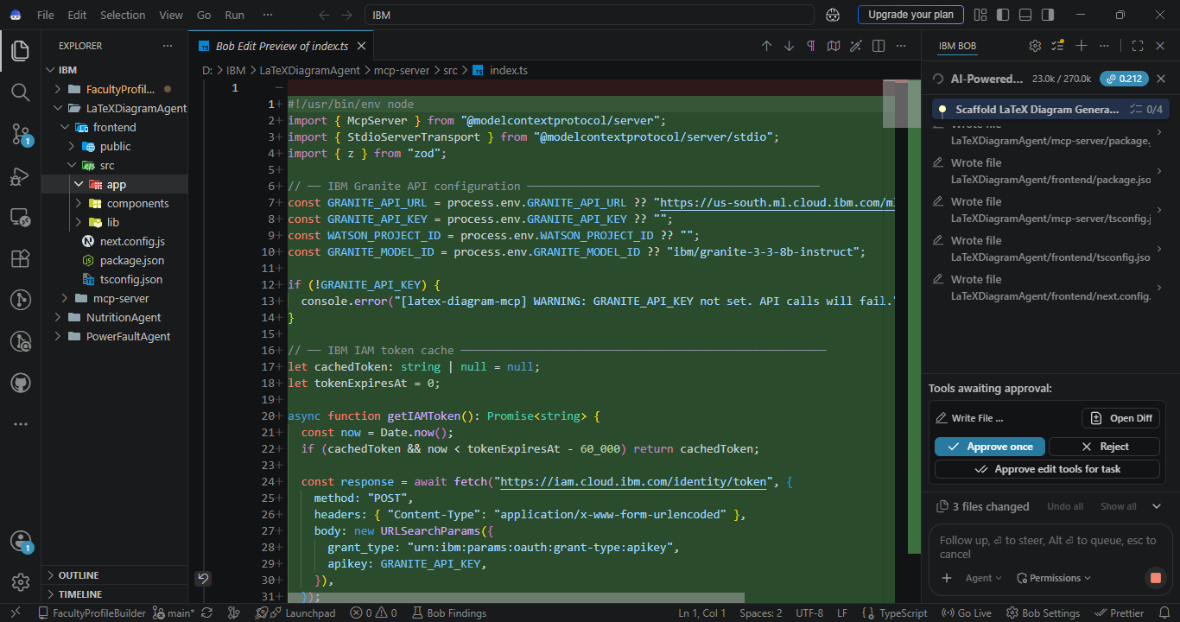
Required Files created using IBM bob -

Slide 7
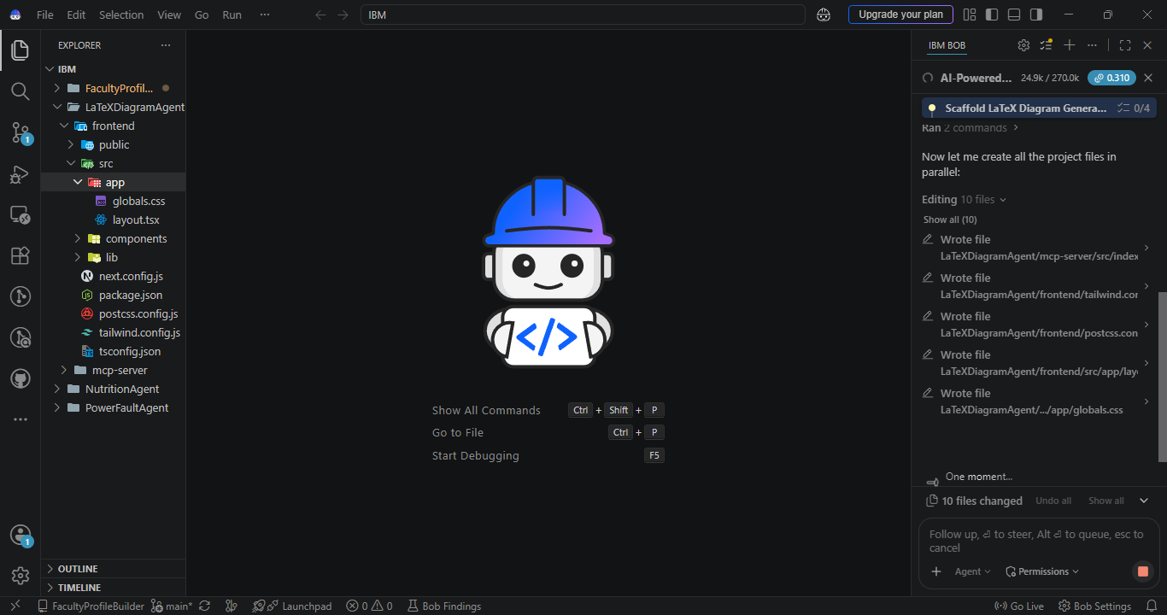
IBM Bob Screenshots:

Slide 8
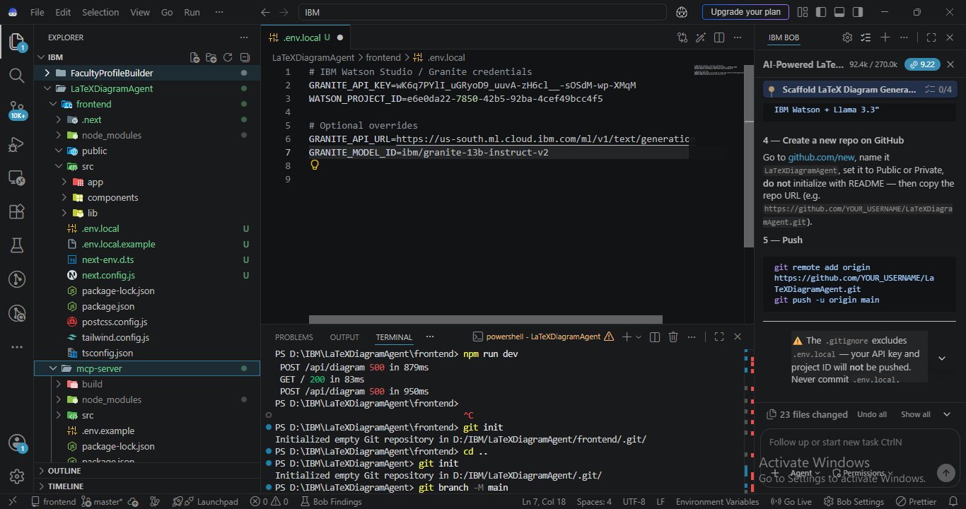

Slide 9
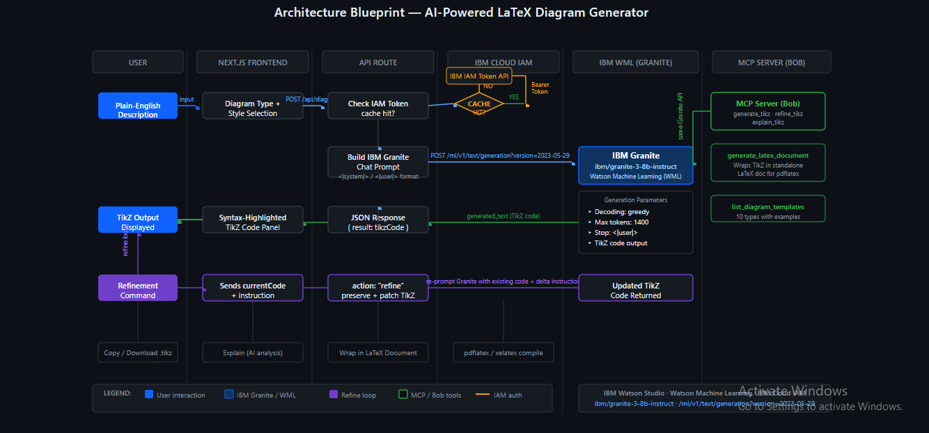
Architecture blueprint for IBM bob:

Slide 10

Role of Agentic AI in the solution
Role of Agentic AI in the LaTeX TikZ Diagram Generator
Agentic AI enables the system to move from simple textgeneration to an interactive diagram-generation workflow.Users describe a diagram in natural language, and theagent generates TikZ code that can be reviewed, refined,explained, and wrapped into a standalone LaTeX document.
The workflow supports specialized actions through MCPtools: generate, refine, explain, wrap, and list templates.This allows users to iteratively improve diagrams usingplain-English instructions instead of manually editingcomplex TikZ syntax.
The system combines a Next.js frontend, IBM Granitemodel inference through Watson Studio, and an MCPserver that exposes the diagram capabilities to IBM Bob.This makes the solution interactive, modular, and suitablefor academic diagram creation.

Slide 11
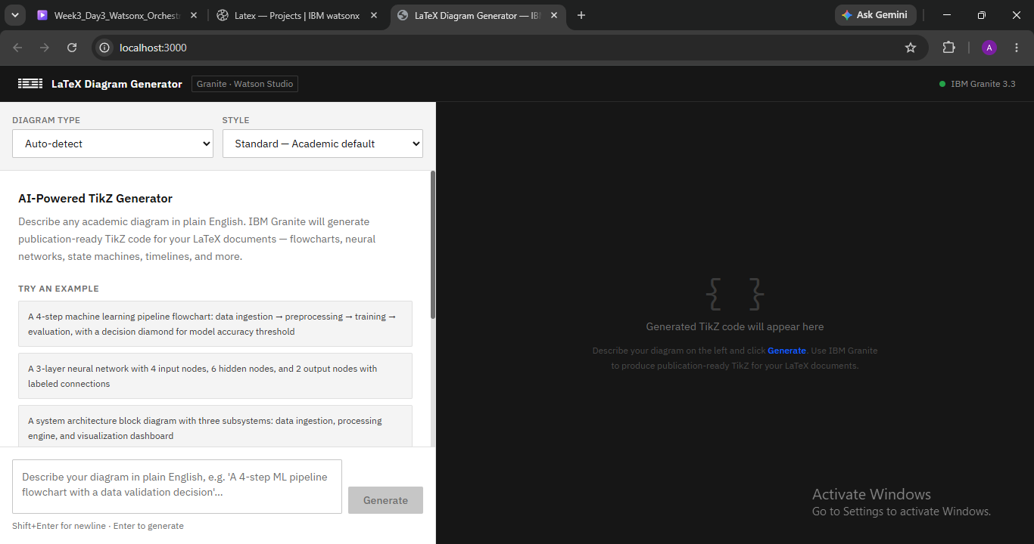
Project Output Screenshot
Please put IBM Bob output screenshots with 2-3 prompts.
You can take 2-3 more slides for each screenshot
·
·
·

Slide 12
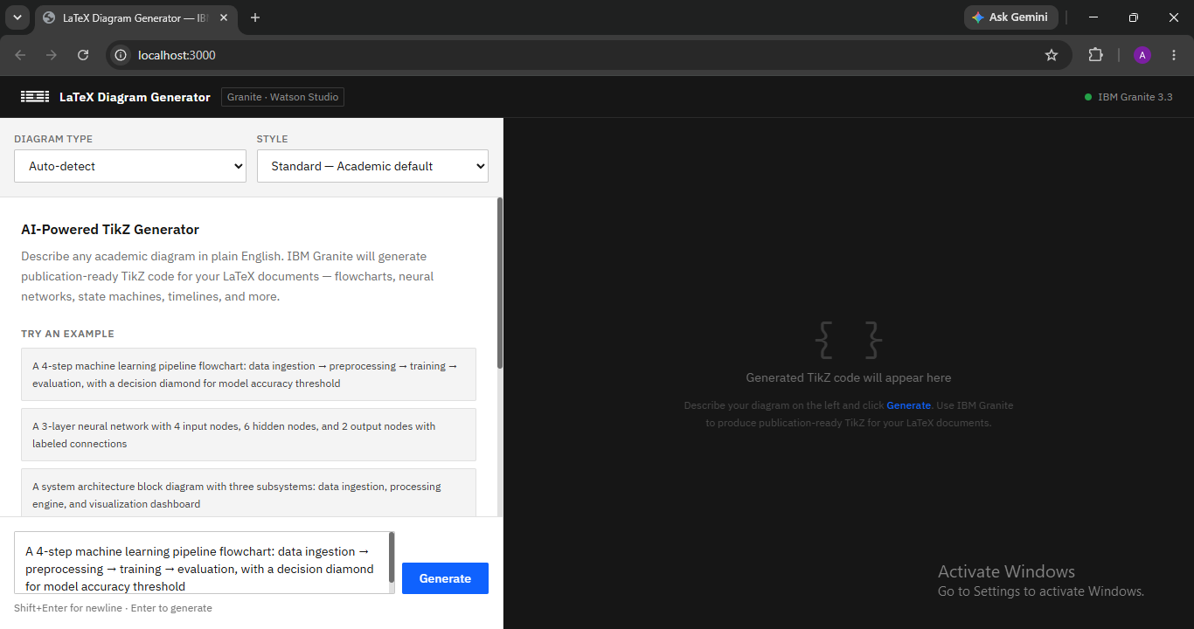
Project Output Screenshot
·
·
·

Slide 13
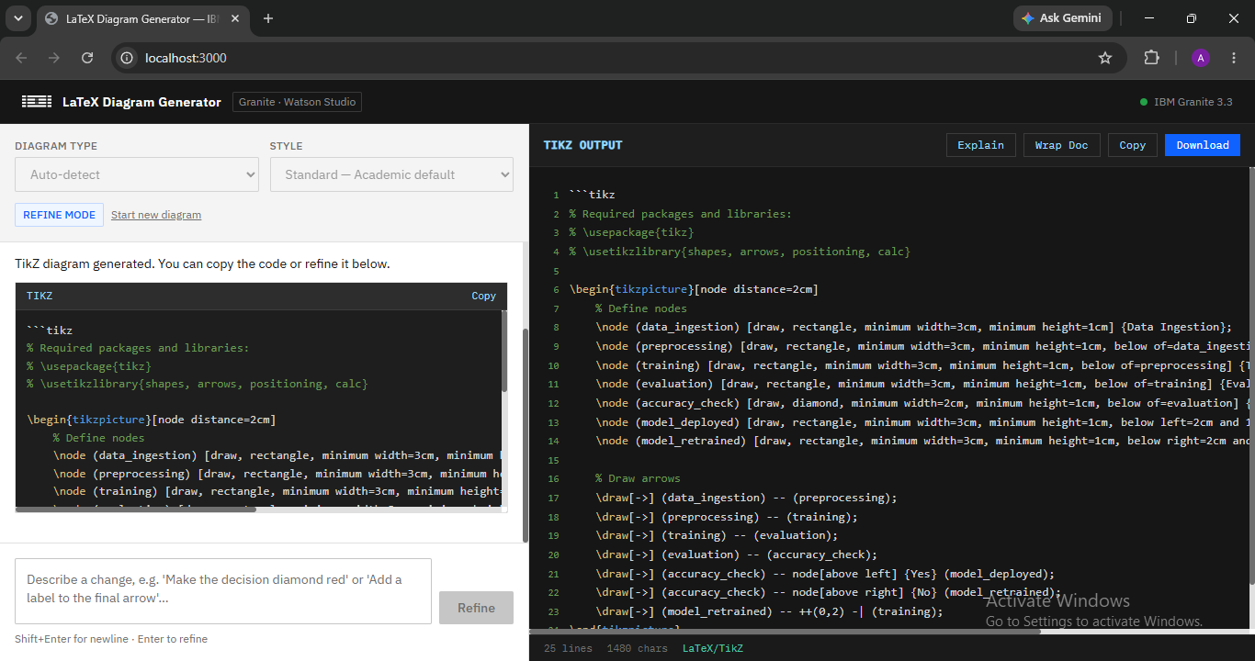
Project Output Screenshot
·
·
·

Slide 14
Novelty and Uniqueness
The proposed LaTeX TikZ Diagram Generator stands out by combining natural-languageinteraction, IBM Granite, TikZ generation, refinement, and IBM Bob integration.
Natural Language → TikZ – Converts plain-English diagram descriptions into compilable TikZ.
10 Diagram Types – Supports flowchart, neural network, block diagram, state machine, sequence,tree, graph, circuit, timeline, and mindmap.
Plain-English Refinement – Users can request targeted visual and structural changes withoutmanually editing code.
Style Presets – Minimal, Standard, and Detailed options support different presentation needs.
Explain & Improve – Existing TikZ can be analyzed with publication-quality improvementsuggestions.
One-Click LaTeX Wrapping – Generated TikZ can be placed into a standalone LaTeX documentfor compilation.
MCP Integration – Five tools make the capabilities available to IBM Bob.
This makes the solution an interactive AI assistant for producing professional academic diagramsrather than a static code generator.

Slide 15
Git Hub Link
https://github.com/Aslam6674/AI-powered-LaTeX-TikZ-diagram-generator
·
·
·

Slide 16
Future Scope
1. Expand Diagram Templates – Add more specialized academic and engineeringdiagram templates beyond the 10 currently supported types.
2. Advanced TikZ Refinement – Extend plain-English refinement to more detailedlayout, styling, and structural transformations.
3. Enhanced Publication Workflows – Further improve Explain & Improvecapabilities for publication-quality diagrams and LaTeX documents.
4. Broader IBM Bob Workflows – Extend MCP tools and agentic workflows foradditional diagram-generation and document-preparation tasks.
5. Regional / Deployment Flexibility – Support additional Watson Studio regions andconfigurable Granite deployments through the existing environment-variablearchitecture.
·
·
·

Slide 17
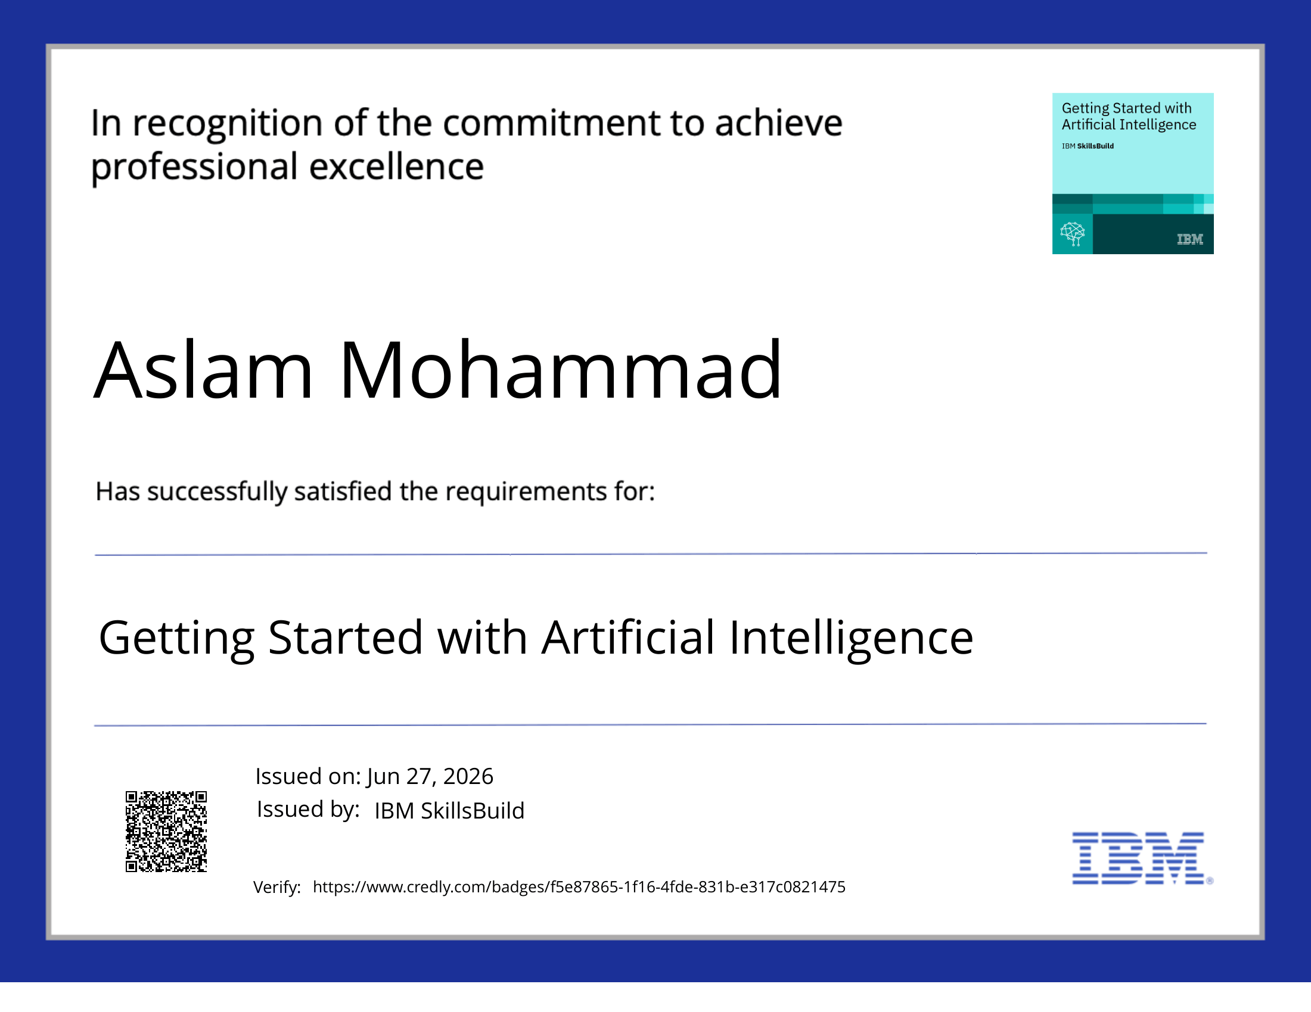
Certificates Earned:

Slide 18
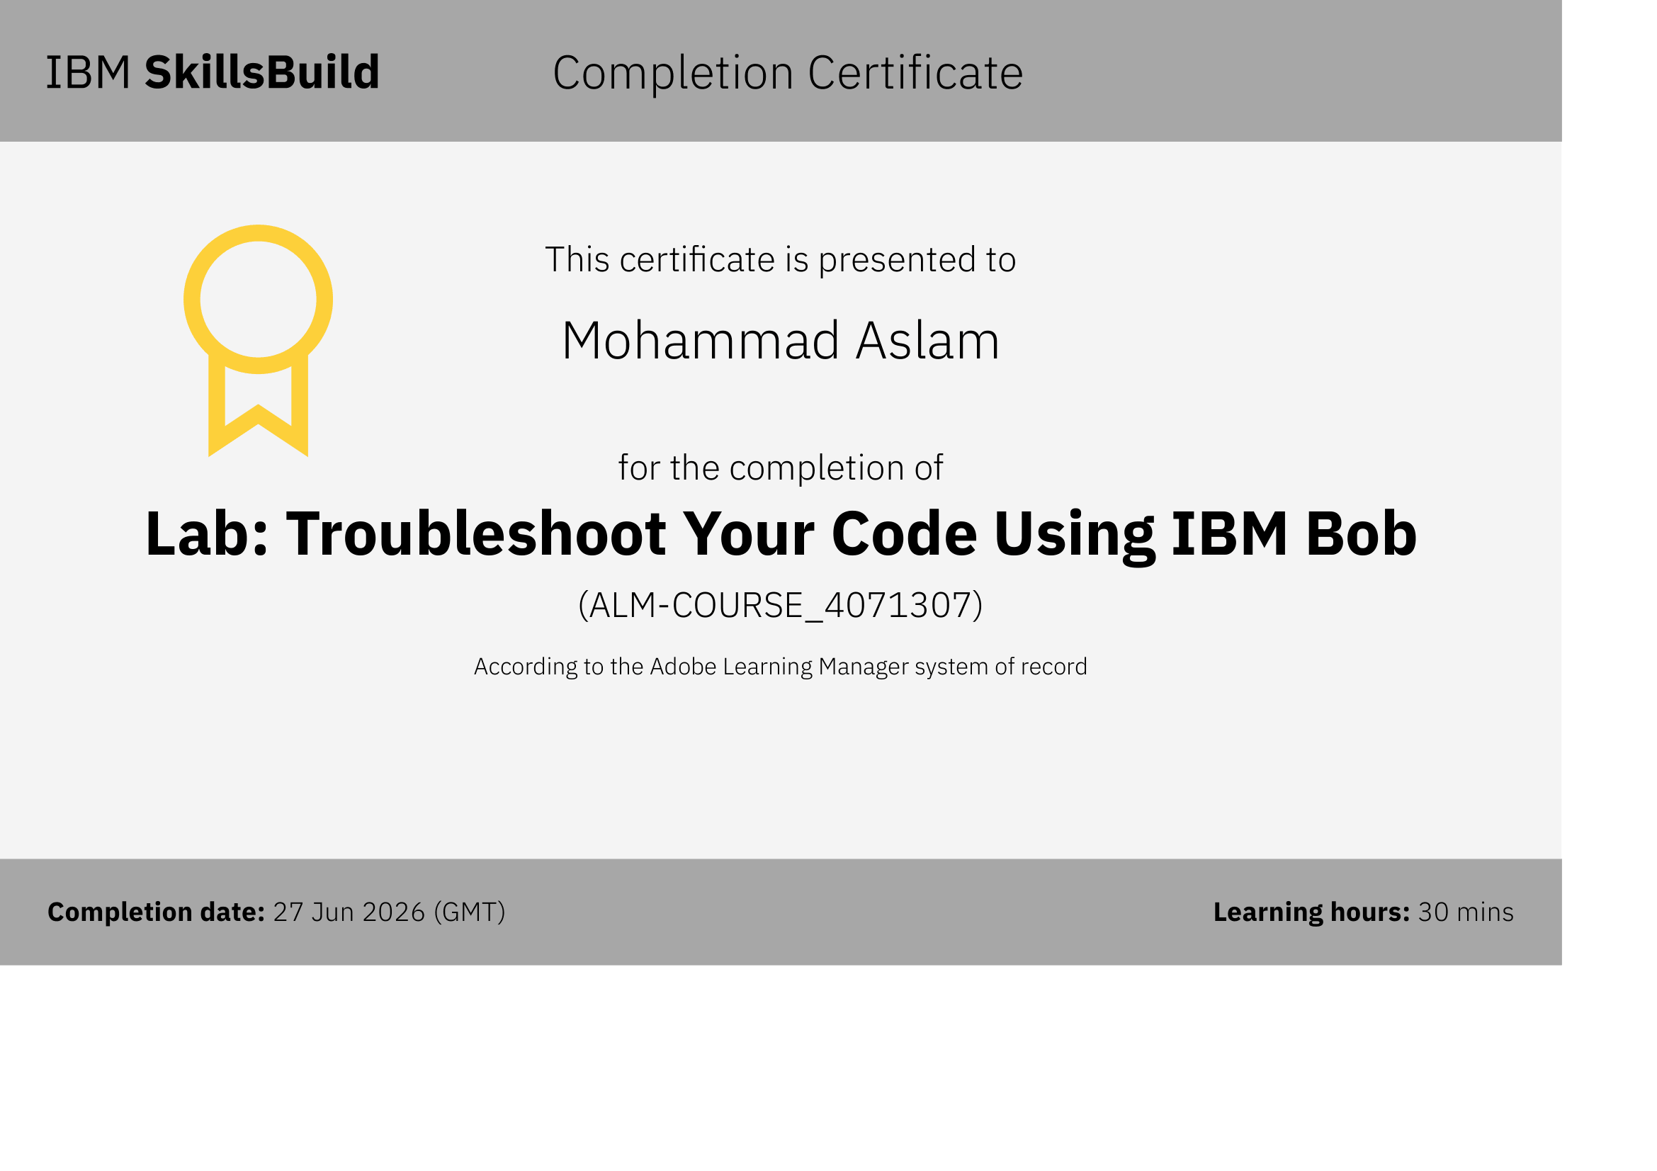
Certificates Earned:​

Slide 19


